Slide 1
Introduction to Data Structures, Applications

Slide 2
What is Data Structure?
Data Structure is a way of organizing all data items that considers not only the elements stored but also their relationship to each other.
Data structure is a representation of the logical relationship existing between individual elements of data.
Data: are simply a value are set of values of different type which is called data type like string, Integer, Char etc.
Structure: way of organizing information, so that it is easier to use.

Slide 3
Data Structure mainly specifies the following four things
Organization of Data
Accessing methods
Degree of associativity
Processing alternatives for information
Algorithm + Data Structure = Program
Interface−Each data structure has an interface.
Interface represents the set of operations that a data structure supports. An interface only provides the list of supported operations, type of parameters they can accept and return type of these operations.
Implementation−Implementation provides the internal representation of a data structure. Implementation also provides the definition of the algorithms used in the operations of the data structure.

Slide 4
Characteristics of a Data Structure
Correctness− Data structure implementation should implement its interface correctly.
Time Complexity− Running time or the execution time of operations of data structure must be as small as possible.
Space Complexity− Memory usage of a data structure operation should be as little as possible.

Slide 5
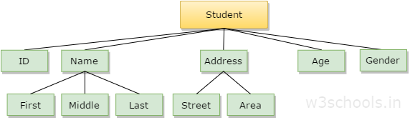
Let us take an example where the name of the student may be divided into three sub-items namely: first name, middle name and last name. But the ID that is assigned to a student would normally be considered as a single item
In the example mentioned above such as ID, Age, Gender, First, Middle, Last, Street, Area, etc. are elementary data items, whereas (Name, Address) is group data items.

Slide 6
Basic Operations of Data Structures
Some specific operations process all data in the data structures. The specific data structure that has been chosen mostly depends on the number of time of the occurrence of the operation which needs to be carried out on the data structure. Names of such operations are listed below:
Traversing
Searching
Insertion
Deletion
Sorting
Merging

Slide 7
Classification of Data Structure

Slide 8
Basic types of Data Structures
Anything that can store data can be called as a data structure, hence Integer, Float, Boolean, Char etc, all are data structures. They are known as Primitive Data Structures.
Then we also have some complex Data Structures, which are used to store large and connected data. Some example of Abstract Data Structure are :
Linked List
Tree
Graph
Stack, Queue etc.
All these data structures allow us to perform different operations on data. We select these data structures based on which type of operation is required.

Slide 9
The data structures can also be classified on the basis of the following characteristics:
Characterstic | Description
Linear | In Linear data structures,the data items are arranged in a linear sequence. Example: Array
Non-Linear | In Non-Linear data structures,the data items are not in sequence. Example: Tree, Graph
Homogeneous | In homogeneous data structures,all the elements are of same type. Example: Array
Non-Homogeneous | In Non-Homogeneous data structure, the elements may or may not be of the same type. Example: Structures
Static | Static data structures are those whose sizes and structures associated memory locations are fixed, at compile time. Example: Array
Dynamic | Dynamic structures are those which expands or shrinks depending upon the program need and its execution. Also, their associated memory locations changes. Example: Linked List created using pointers

Slide 10
What is an Algorithm ?
An algorithm is a finite set of instructions or logic, written in order, to accomplish a certain predefined task. Algorithm is not the complete code or program, it is just the core logic(solution) of a problem, which can be expressed either as an informal high level description as pseudocode or using a flowchart.

Slide 11
Every Algorithm must satisfy the following properties:
Input- There should be 0 or more inputs supplied externally to the algorithm.
Output- There should be atleast 1 output obtained.
Definiteness- Every step of the algorithm should be clear and well defined.
Finiteness- The algorithm should have finite number of steps.
Correctness- Every step of the algorithm must generate a correct output.

Slide 12
Time Complexity Of A Computer Program
“Whats the time complexity of the solution ?”
“Can you improve the time complexity of your solution ?”
which is why its essential for us to understand the basics of time and space complexity.

Slide 13
How To Calculate Running Time?
Running Time Depends Upon
1. Single vs Multiprocessor
2. Read/Write Speed to Memory
3. 32 bit vs 64 bit
4.Input
->rate of growth of time
Example
Model Machine
1.Single Processor
2. 32 bit
3. Sequential execution
4. 1 unit time for arithmetical and Logical operations
5. 1 unit time for assignment and return

Slide 14
Example 1
Sum (a,b)
{
Return a+b;
}
Example 2
Sum of List (a,n)
{
Total=0
For i=0 to n-1
total = total + Ai
Return total
}
Ex 1
Tsum = 2(constant time algorithm)
Ex 2
T sum of list = 1+2(n+1)+2n+1
= 4n+4
T(n)=Cn + C’ ( linear)
Where C=C2+C3
C’=c1+c2+c4
Cost no of times
1 (c1) 1
2 (c2) n+1
2 (c3) n
1 (c4) 1

Slide 15
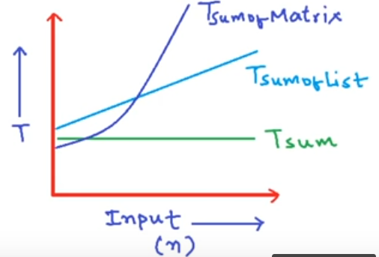

Tsum = k O(1)
Tsum of list = c . n + c’ O(n)
Tsum of matrix = a $n^{2}$ + bn + C O($n^{2}$)

Slide 16
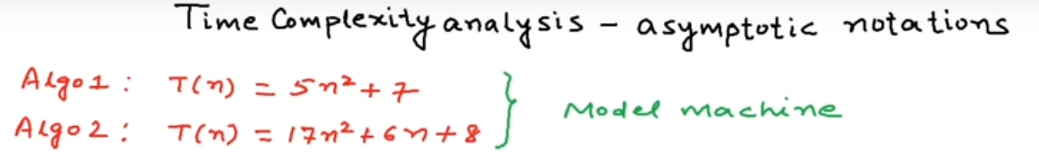
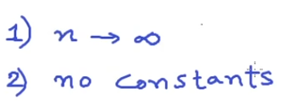

Slide 17
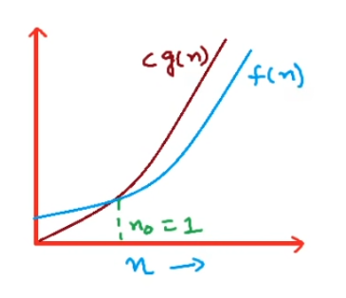

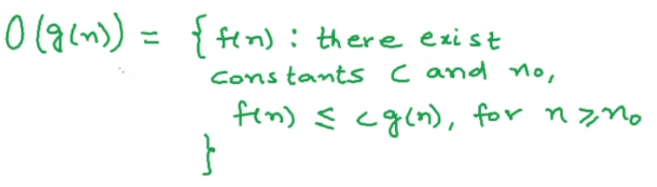
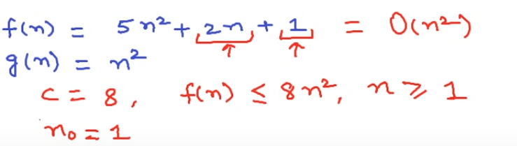
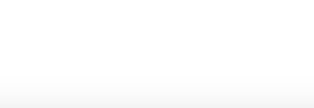

Slide 18
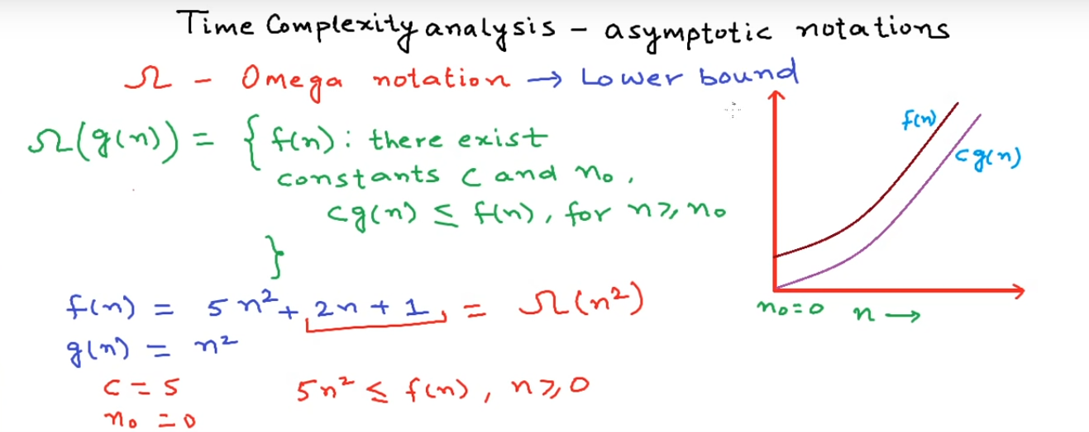

Slide 19
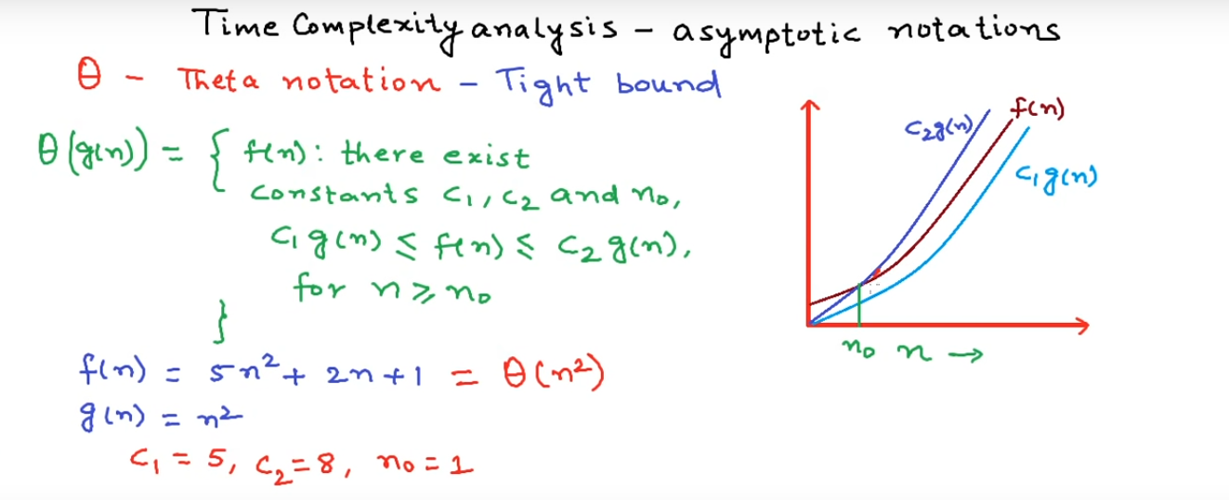

Slide 20
Time Space
Operations Variable
Comparisons Data Structure
Loop Stuff Allocation
Pointer References Function calls
Function calls to outside

Slide 21
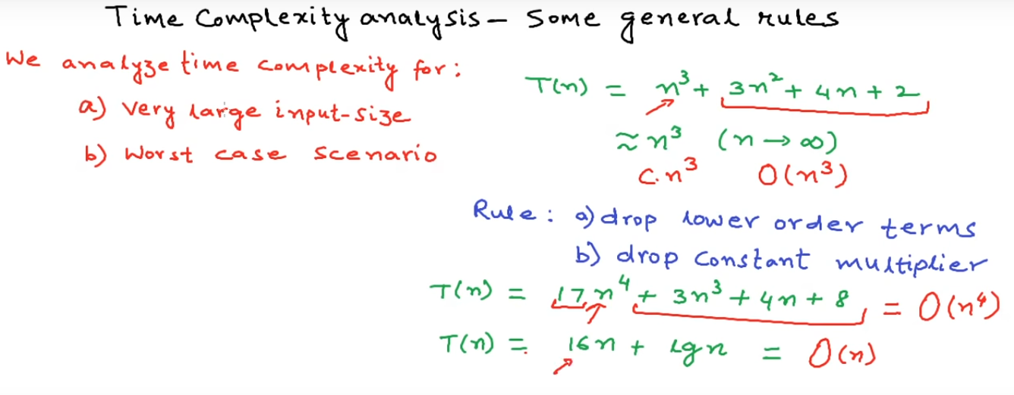

Slide 22
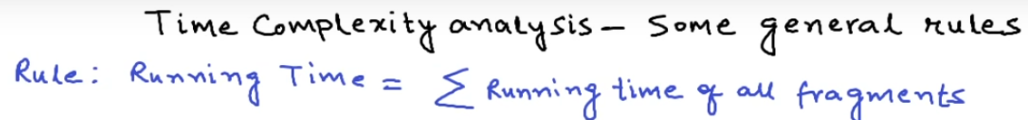
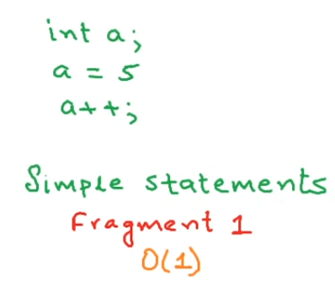
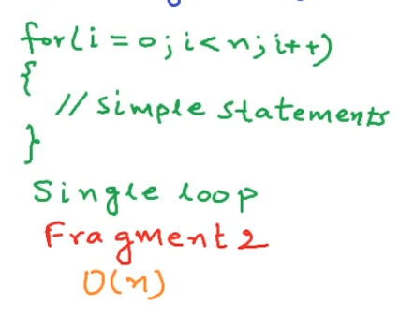

Slide 23
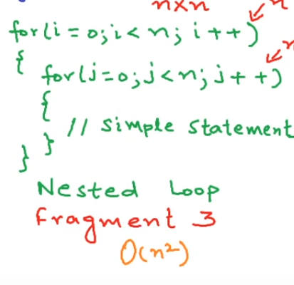

Slide 24
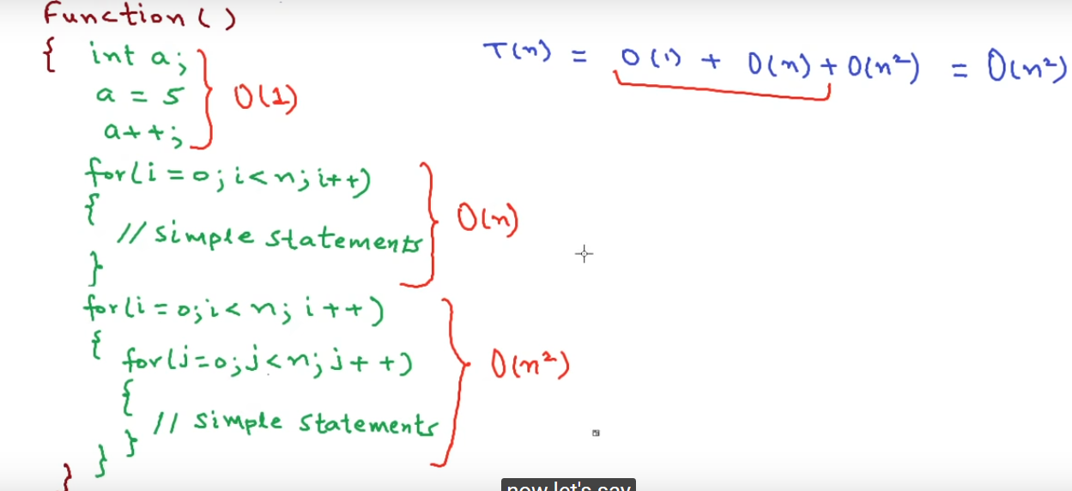

Slide 25
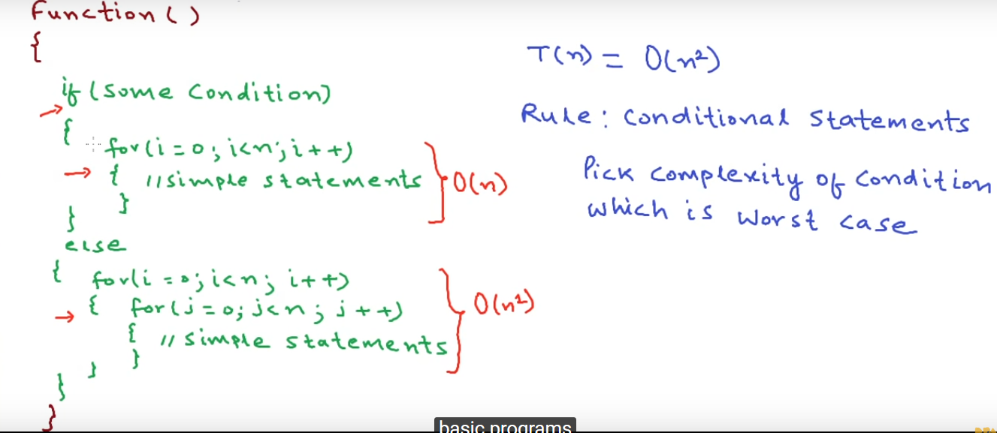

Slide 26
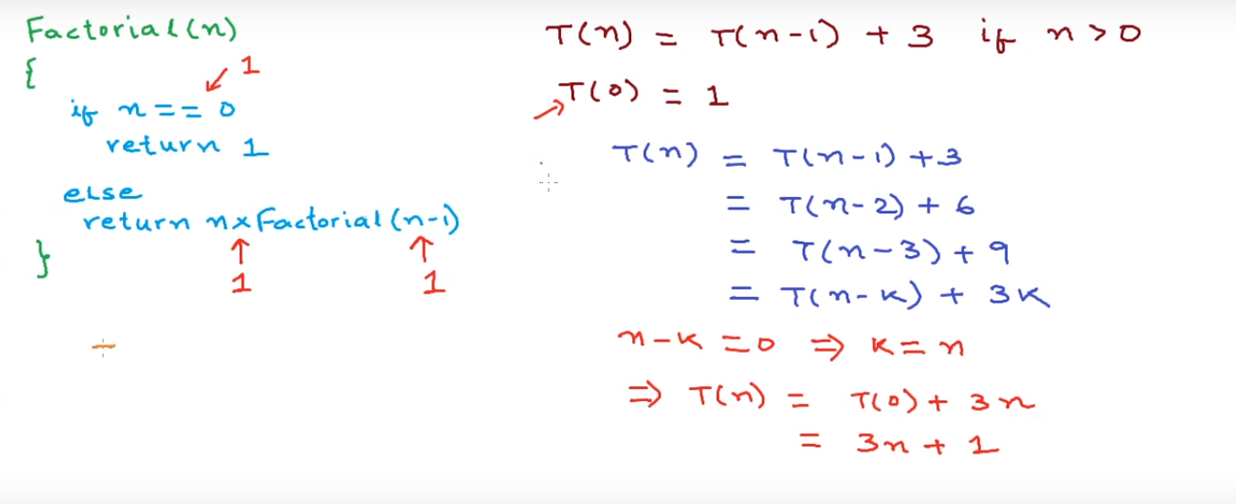
Time and Space Complexity for Recursive Programs

Slide 27
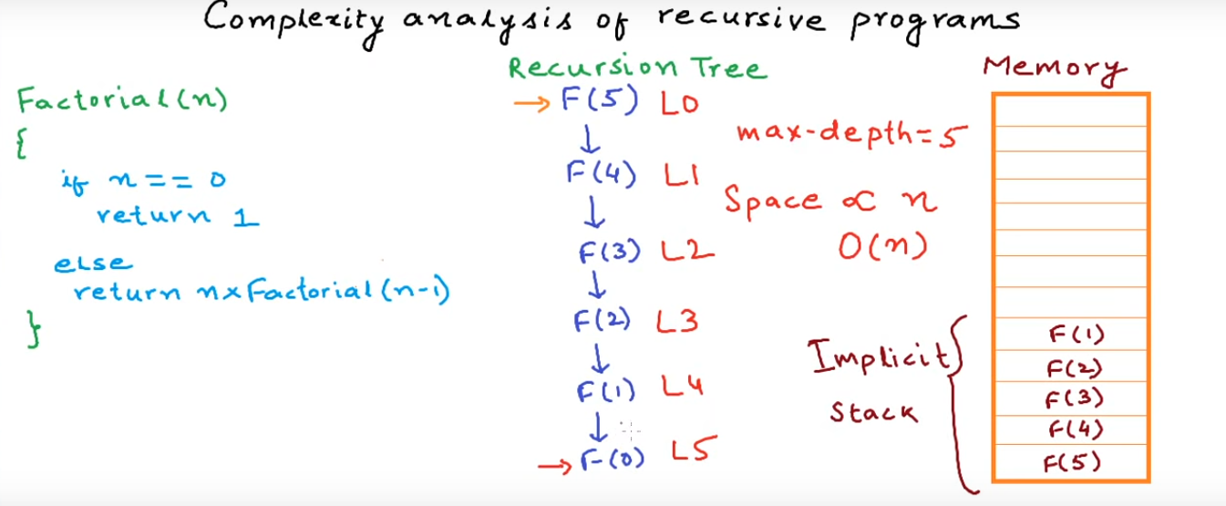
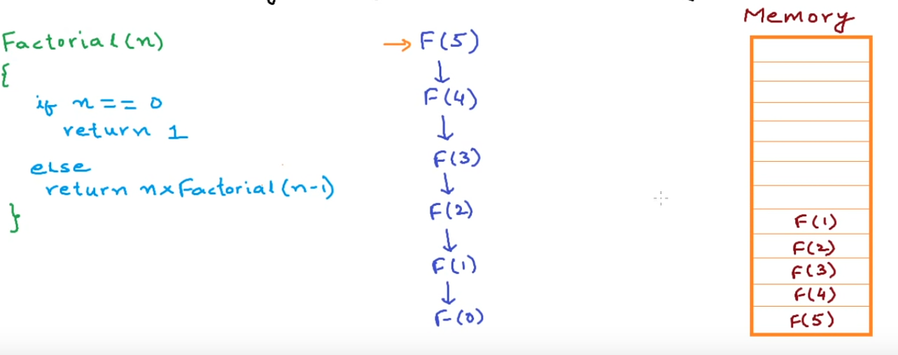
Space Complexity for Recursive Programs

